Slide 1
New Philology and 21st Century Editors:
Arabic Infancy Gospel of Thomas as a Use Case
Slavomír Čéplö
(BBAW)

Slide 2
Why all of this?
1. General thoughts/seeking advice from potential readers on
  an introduction to a new edition* of Arabic versions/recensions of the Infancy Gospel of Thomas
  the edition* itself
2. Practical issues in working with open/fluid traditions
3. I read something and now I have THOUGHTS

Slide 3
Part 1: Old vs. New
Old Philology
How to do Old Philology
New Philology
How to do New Philology
Part 2: Arabic Infancy Gospel of Thomas (AIGT)
AIGT in the Arabic Infancy tradition
AIGT Manuscripts
AIGT Composition
The von Stockhausen method
Variant presentation
Conclusion

Slide 4
Part 1: Old vs. New

Slide 5
Old Philology
= textual criticism/Textkritik (in the narrow sense)
= philology (in the narrow sense)
= the Lachmann method
= the (Neo)Lachmannian method/technique (Trovato 2014)
“Aufgabe der Textkritik ist Herstellung eines dem Autograph (Original) möglichst nahekommenden Textes (constitutio textus).”
Maas 1957: 1

Slide 6
How to do Old Philology: An informal survey

Slide 7
How to do Old Philology: Process
Step | Entails
1. Collection | collecting manuscript witnesses
2. Collation | comparing witnesses, establishing their relationship
3. Selection | analysis of errors, elimination of witnesses, construction stemma
4. Examination | reconstruction of the text
5. Emendation | using correction and conjecture to restore the original text
Bird, Graeme D. Multitextuality in the Homeric Iliad: The Witness of the Ptolemaic Papyri. Cambridge (Mass.): Center for Hellenic Studies, 2010.

Slide 8
How to do Old Philology: Process – Data Model
data model (n.) “a way to (1) atomize and (2) organize the (information about the) object of analysis”
(1) atomize Fundamental unit of analysis: word - the pivot as well | (2) organize types of variants (lectio difficilior,lectiones in singulares) (add., om., inv.) types of errors (homoeoteleuton, homoearcton, homoeomeson, dittography, haplography, ita/iotacism) types of relationships between manuscripts (contaminatio, codices descripti, ultrum in alterum abiturum erat)
inconsistent
mixing categories
not unified

Slide 9
How to do Old Philology: Process – Collation
 | position 1 | position2 | position 3 | position 4 | position 5 | position 6
P | O | kari | miei | fratri | ke | malamente
L |  | cari | mei |  | con | malame(n)/te
V | Oj | chari |  |  | che
R |  | chari | mei |  | con
for manuscript in [L, V, R]:
for position in P:
if manuscript[position] != P[position]:
return manuscript[position]
else:
return None
Trovato and Reeve 2014: 63

Slide 10
How to do Old Philology: Process – Selection
 | position 1 | position2 | position 3 | position 4 | position 5 | position 6
P | O | kari | miei | fratri | ke | malamente
L |  | cari | mei |  | con | malame(n)/te
V | Oj | chari |  |  | che
R |  | chari | mei |  | con
E_{L} = {cari, mei, con}
E_{V} = {oj, chari, che}
E_{R} = {chari, mei, con}
E_{L} ∩ E_{V} = {}
E_{L} ∩ E_{R} = {mei, con}
E_{V} ∩ E_{R} = {chari}
((L(R))V)
error sets
manuscript affinity

Slide 11
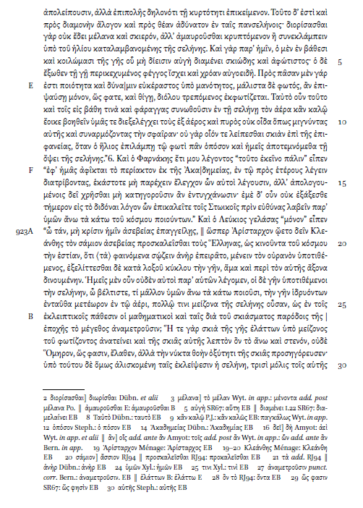
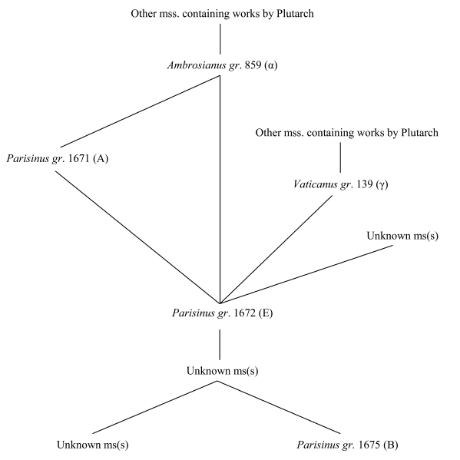
How to do Old Philology
Plutarch De facie quae in orbe lunae apparet (Gárriga 2021)

Slide 12
[SIDEBAR] Old Philology: A naïve view
“…textual criticism aims at a point closer to pure science than does most research in the humanities…”
King 2021: 519

Slide 13
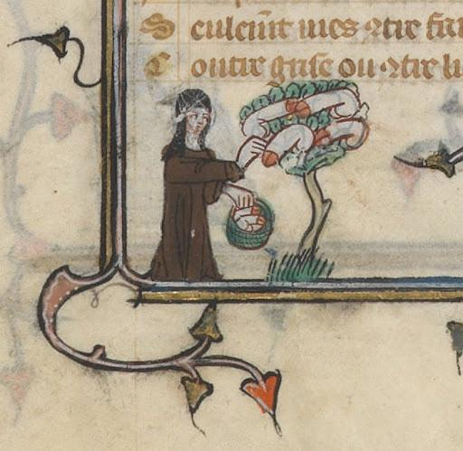
[SIDEBAR] Old Philology: A naïve view
“…textual criticism aims at a point closer to pure science than does most research in the humanities…”
King 2021: 519
”Humanities” vs. “science”
Just because you can formalize it, it does not mean it is “science”

Slide 14
New Philology: Manuscripts at the forefront
“… focus on the material artifact constituted by the manuscript …”
Lundhaug and Lied 2017: 6
“…texts should not be studied as abstract texts divorced from the physical form of their presentation.”
Lundhaug and Lied 2017: 7

Slide 15
New Philology: Textual fluidity
“… in a manuscript culture, texts are inevitably changed… and so they develop, sometimes in major and significant ways, along their histories of transmission…”
Lundhaug and Lied 2017: 9
“In such circumstances, in which not only the lines of descent but also the direction of descent are indeterminable, a documentary or genealogical approach is inoperable: it cannot determine whether agreement in error is evidence of common descent or of mixture among lines of descent, and the reconstruction of a usable genealogical stemma of the textual tradition becomes impossible.”
Holmes 2013: 783

Slide 16
New Philology: Textual fluidity
folk literature
apocryphal literature
hagiography
para-biblical literature
sermons
Gebrauchstexte
all kinds of texts in wide distribution

Slide 17
How to do New Philology: Not the old way
no (attempts to recover) authorial text
no “errors”, only variants
every(?) manuscript matters
every(?) variant matters
→ Old Philology methods inapplicable

Slide 18
[SIDEBAR] Parallels in linguistics
“Perspectives akin to those promoted by New Philology have gained a foothold in several disciplines.”
Lundhaug and Lied 2017: 9
Old linguistics | New linguistics
Focuses on abstract “language” or “Universal Grammar” | Studies language(s) as attested
Introspection | Empirical data
Writes off variation as “performance errors” | Sees variation as a part of language

Slide 19
How to do New Philology: Maybe the old way
Confronted with situations of that kind [open/fluid traditions] editors must choose between an eclectic approach that draws on multiple witnesses and constructs a text that is identical to none of them and what Gary Taylor has called a ‘versioning’ approach, that is, reconstructing or reproducing separate authorial versions of a text.
Tarrant 2016: 3
A reasoned eclecticism, however, can deal with an “open” textual tradition.
Holmes 2013: 783

Slide 20
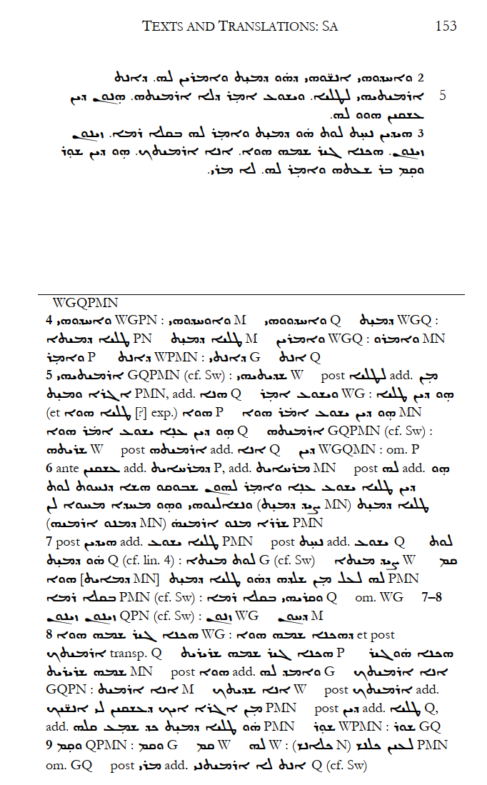
How to do New Philology: Maybe the old way
Burke (2019)
3 “recensions” of the Syriac tradition of the Inf. Gos. Thom.
Sa
Se
Sw
… a ‘versioning’ approach…
Tarrant 2016: 3

Slide 21
How to do New Philology: Maybe the old way
“… critical editions … the inviolable touchstone of scholarly knowledge and achievement.”
“Critical editions … have been a central part of the humanities for centuries.”
Burdick et al. 2015: 7, 35
“…post-heroic age…”
Tarrant 2016: 18

Slide 22
How to do New Philology: … or maybe not
“… critical editions … the inviolable touchstone of scholarly knowledge and achievement.”
“Critical editions … have been a central part of the humanities for centuries.”
Burdick et al. 2015: 7, 35
“…post-heroic age…”
Tarrant 2016: 18
“…heroic editor…”
acute intelligence
total dedication to editorial work on a wide range of texts
quickness to suspect the text as transmitted in manuscripts
fertility in conjecture
confidence in judgement
and authoritativeness in expression
        Tarrant 2016: 19

Slide 23
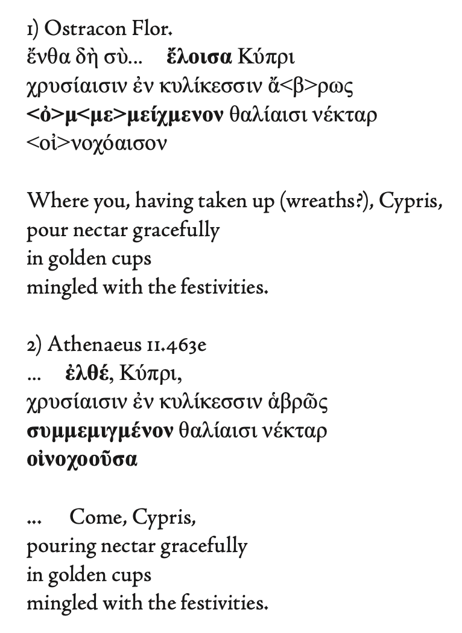
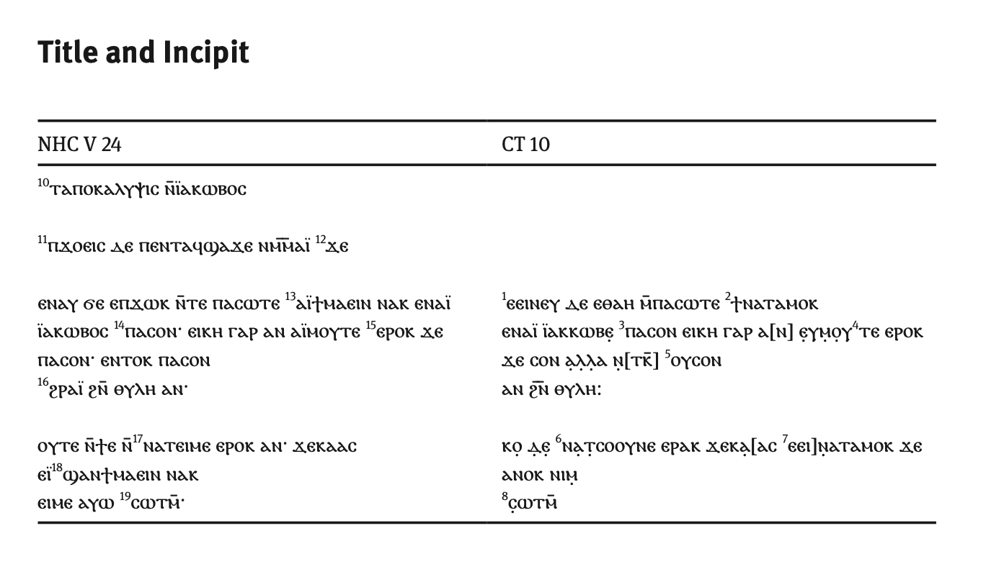
How to do New Philology: Maybe differently?
Klooster 2014: 259 (Sappho)
Jennott 2017: 64 (The First Apocalypse of James)

Slide 24
How to do New Philology?
How to record/note the variants?
How to present them?
… and their translations and/or parallels?
Is there even a point to making an “edition”?
If not, what should replace it?
And regardless, how to do it technically?

Slide 25
Part 2: Arabic Infancy
Gospel of Thomas (AIGT)

Slide 26
AIGT in the Arabic Infancy tradition
Infancy = narratives depicting Jesus as a child doing stuff
Arabic recension of Infancy Gospel of Thomas (ECCA 421, CANT 57); Ar. Inf. Gos. Thom. → AIGT
Arabic translation of Life of Mary (West Syriac) (ECCA 184, CANT 95); Life Mary
Arabic Infancy Gospel (ECCA 596, CANT 58); Arab. Gos. Inf.
Vision of Theophilus (ECCA 621, CANT 56); Vis. Theo.
Life of John the Baptist, by Serapion (ECCA 594, CANT 183); Life Bapt. Serap.
(Apocryphal) Gospel of John (ECCA 518, CANT 44); Apocr. Gos. John.

Slide 27
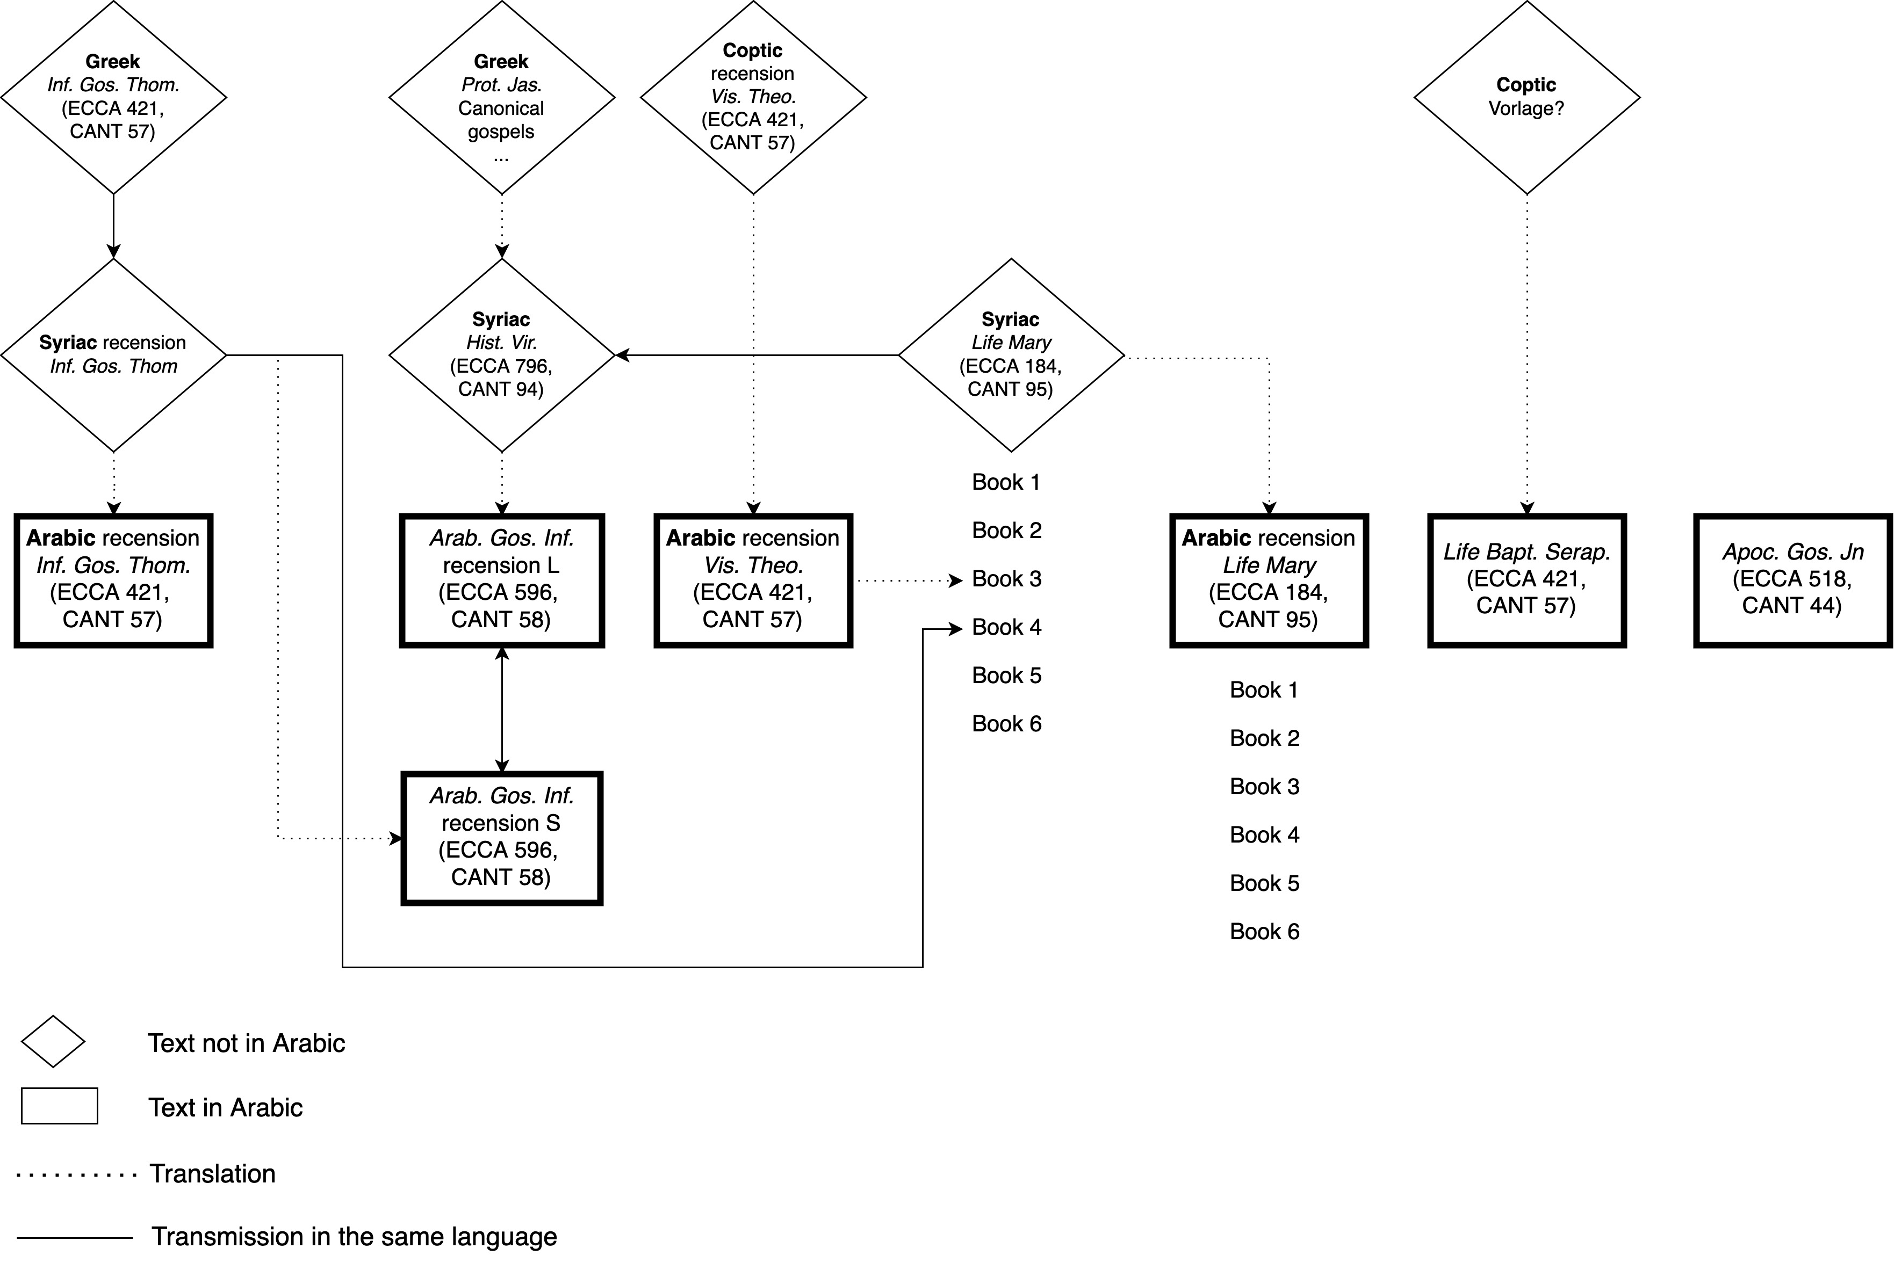

Slide 28
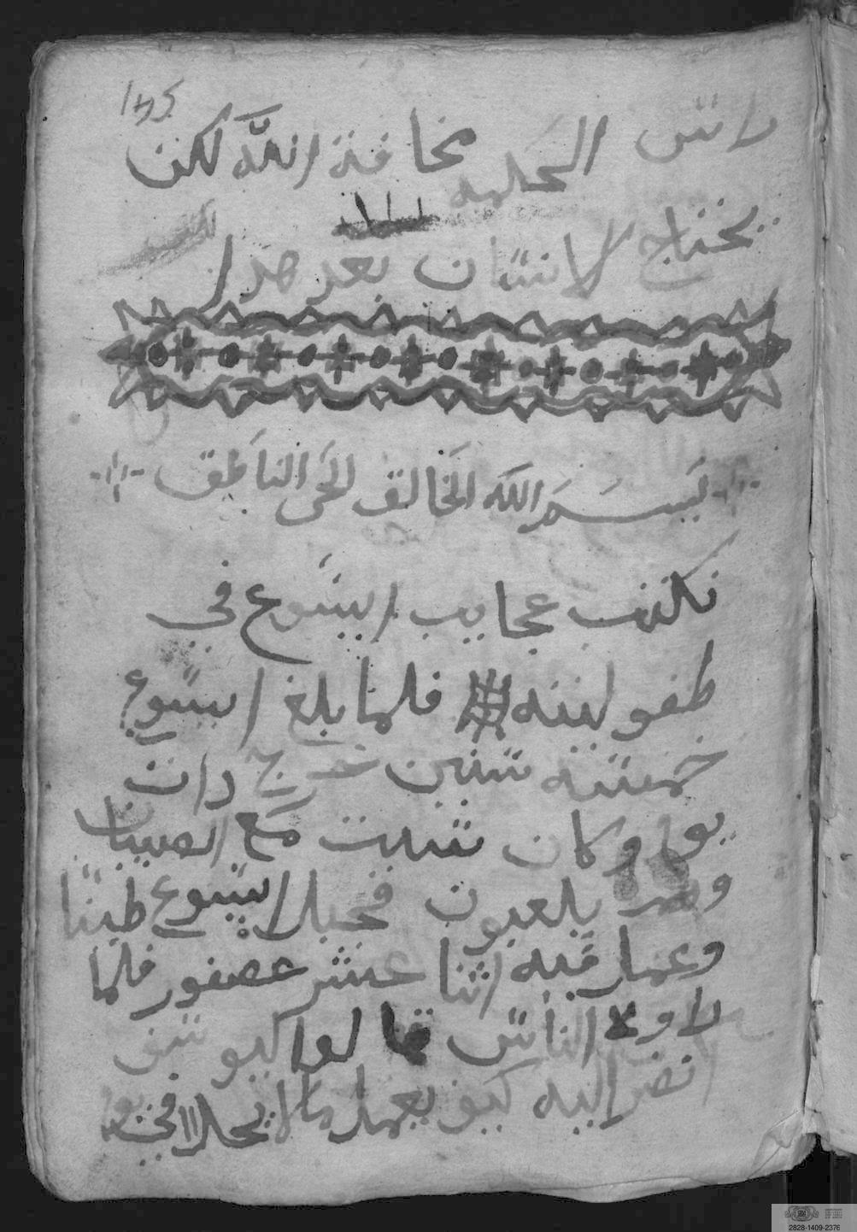
AIGT manuscripts
A Milan, Biblioteca Ambrosiana, G 11 sup, fols. 145^{r}–153^{v}
(date undetermined)
Moraldi, Luigi. “Infanzia di Gesù: ms. arabo G 11 sup. della Biblioteca Ambrosiana.” Rendiconti: Istituto Lombardo Di Scienze e Lettere 127, no. 1 (1993): 79–91.
G 11, sup 145^{r}

Slide 29
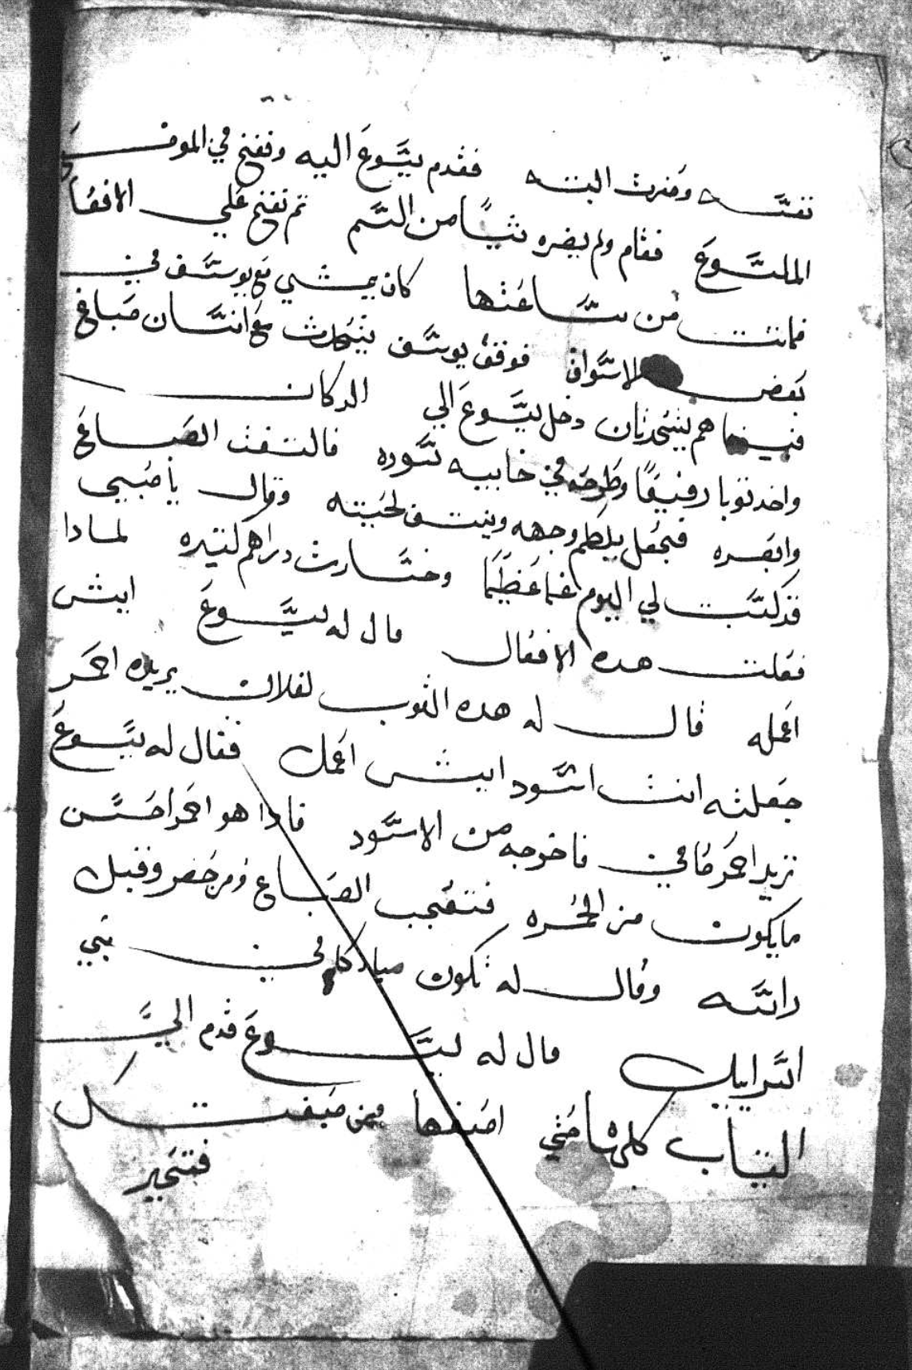
AIGT manuscripts
B Cairo, Coptic Museum, 6539(D)/CM B_9-4, fols. 188^{r}–188^{v}
(date undetermined)
Čéplö, Slavomír. “Appendix: Arabic Infancy Gospel of Thomas.” In The Syriac Tradition of the Infancy Gospel of Thomas, by Tony Burke, 229–39. Piscataway, NJ: Gorgias Press, 2019.
CM 6359, 188^{v}

Slide 30
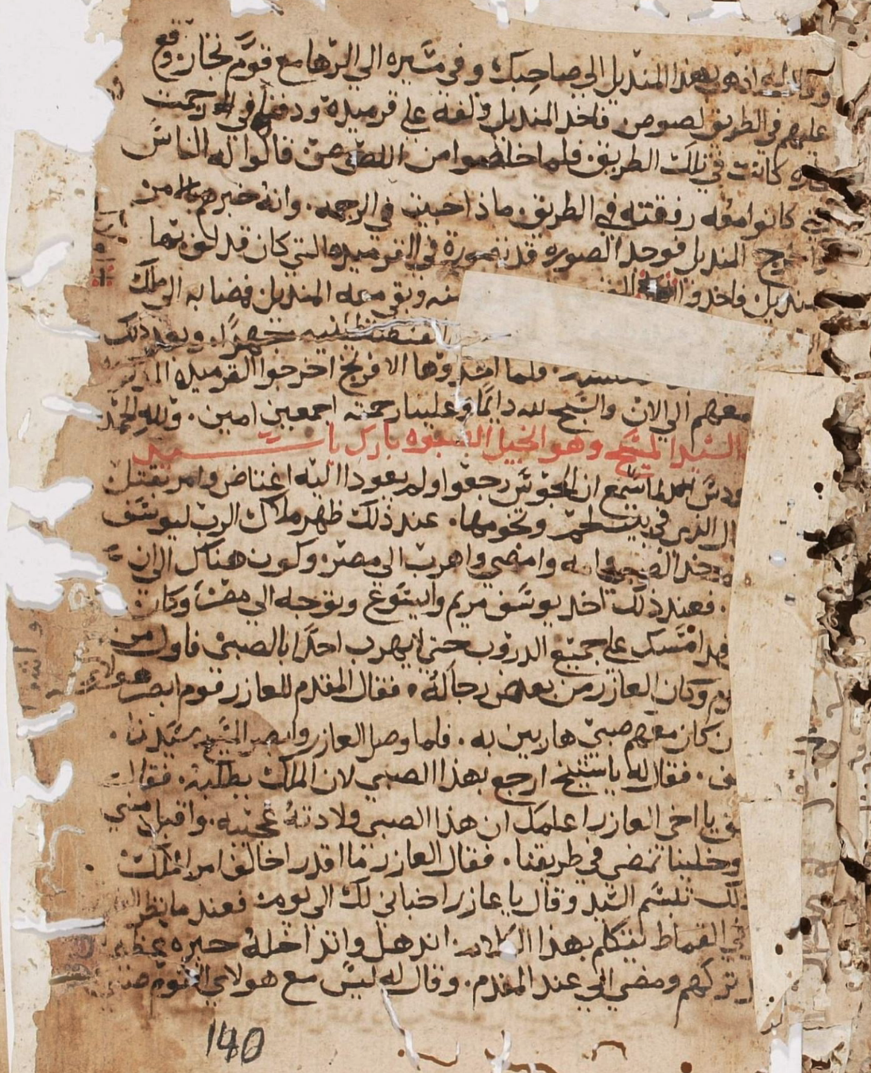
AIGT manuscripts
C Dayr Sayyidat al-Balmand MS 156, fols. 140^{r}-140^{v} + 176^{r}-178^{v}
1606 CE
https://w3id.org/vhmml/readingRoom/view/119442
Unpublished.
DSB 156, 140^{r}

Slide 31
AIGT manuscripts
A (MA G11 sup)
Number | Folios | Work
1 | 7r-68r | Fragmentary theological text
2 | 29r-48r | “Ten questions” (a theological compendium)
3 | 145r-153r | AIGT
4 | 154r-157r | Two hymns
B (CM B_9-4): single leaf in a collection of fragments

Slide 32
AIGT manuscripts: C (DSB 156)
Code | Folios | Other NT apocrypha: Work title and reference
[A01] | 7r-68r | *Miracles of Mary (ECCA 512)
[A02] | 70r-80r | Acts of Andrew and Bartholomew (ECCA 319, CANT 238); Acts Andr. Bart.
[A03] | 136r-139v | Preaching of Judas Thaddaeus (ECCA 302); Pre. Jud. Thad.
[A04] | 139v | Acts of Andrew and Matthias (ECCA 517, CANT 236); Acts Andr. Mth.
[A05] | 140r | *Story of the Image of Edessa (ECCA 931); Story. Im. Ed.
[A06] | 140r-140v, 176r-178v | AIGT
[A07] | 141r, 161r-175v | Dormition of the Virgin, Six-Books (ECCA 220, CANT 123, 124, 140, 150, 151); 6 Bks. Dorm.
[A08] | 141r-142v | *Miracles of Mary (ECCA 512)
[A09] | 207r-215r | Miracles of Mary in Bartos (CANT 281); Mir. Mary Bartos
[A10] | 215r-217r | Life of Gerasimos of Emesa (ECCA 500); Life Geras.
[A11] | 217r-217v | Martyrdom of Simon the Canaanite (ECCA 222; CANT 282.2); Mart. Sim. Can.

Slide 33
AIGT Composition: SynInf (cf. Elliott 2016)
SynInf | SynInf (title) | Elliot (code)
LK01 | Jesus in the Temple at the Age of Twelve | T
IG01 | Jesus and the Birds | A
IG02 | Jesus Curses Boy who Dried Pools | A
IG03 | Jesus Curses a Boy who Slapped him | B
IG04 | Jesus’ Ear is Pulled | B
IG05 | Jesus and Zacchaeus the Teacher | C i)
IG06 | Jesus Curses People | C i)
IG07 | Jesus and the Meaning of Alpha | C ii)
IG08 | Jesus and the Teacher who Teaches by Flattery | C iii)
IG09 | Jesus and Zeno | D
IG10 | Jesus Heals a Man's Foot | E
IG11 | Jesus Fetches Water | F
IG12 | Jesus Sows a Field | G
IG13 | Jesus Stretches a Beam for a Bed | H
IG14 | Jesus Heals James' Viper Bite | I
IG15 | Jesus Heals a Sick Child | J
IG16 | Jesus Heals a Workman | K
SynInf | SynInf (title) | Elliot (code)
AI01 | Jesus and the Dyer | P
AI02 | Jesus Turns Boys into Animals | R
AG01 | The Poisoned Boy | N
AG02 | Jesus Stretches a Beam for a Throne | Q
AG03 | Jesus the King | S
AR01 | Jesus and the Sunbeam | U
JB01 | Jesus Flies on a Cloud to the Desert to Console John the Baptist
AJ01 | Jesus and the Thief’s Broken Sword
AJ02 | Jesus and the Oxen
AJ03 | Jesus and the Stolen Fish
AJ04 | Jesus and the Stolen Calf
LK = Luke; IG = Inf. Gos. Thom. (Elliott 2016);
AI = AIGT; AJ = Apocr. Gos. Jn. (Moraldi 1991);
AG = Arab. Gos. Inf.; AR = Armenian tradition

Slide 34
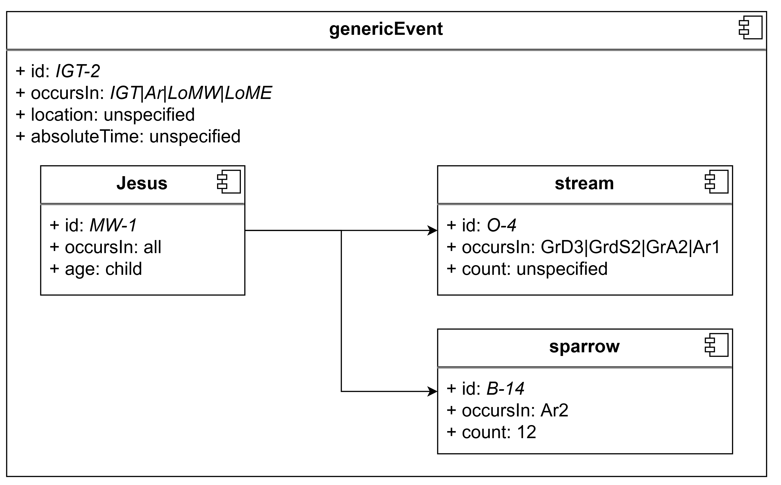
[SIDEBAR]: APOCRYTROPE ©®™
proposed system for the study of the apocryphal (part of the biblical) storyworld
with detailed atomization starting at Motif level
designed as a proper ontology with Entities, Properties, Relationships etc. …
(… often made easier by the nature of the texts)

Slide 35
AIGT Composition
Syr. Sa/Sw | A | B | C
IG01 | IG01 | AI02 | NO_ID
IG02 | IG02 | IG11 | AJ01
IG03 | IG03 | IG13 | IG01
IG04 | IG05 | IG07 | IG02
IG05 | IG09 | IG14 | IG03
IG06 | AI02 | AI01 | IG05
IG09 | IG11 |  | IG09
IG11 | IG13 |  | AI02
IG12 | IG07 |  | IG11
IG13 | IG14 |  | IG13
IG07 | AI01 |  | IG07
IG08 | Concl. |  | AI01
IG14 |  |  | IG14
LK01 |  |  | AJ03
 |  |  | AJ04
 |  |  | AJ05
 |  |  | Concl.
IG03 | Attested in Greek, same order in Syriac and Arabic
 | Same order
 | Different order
NO_ID | Previously unrecorded Infancy story, “The Good Soldier Lazarus”

Slide 36
The von Stockhausen method
“… focus on the material artifact constituted by the manuscript …”
Lundhaug and Lied 2017: 6
“Im Gegensatz zum klassischen Lachmannschen Ansatz … ist es für digitale Editionen … durchaus auch unter Aufnahme des Grundgedankens der New Philology … einer Wertschätzung jedes einzelnen Überlieferungsträgers … angebracht…”
Von Stockhausen (2020: 128)

Slide 37
The von Stockhausen method: Process
<?xml version="1.0" encoding="UTF-8"?>
<TEI xmlns="http://www.tei-c.org/ns/1.0"
⋍ diplomatic
edition
Volltext-Transkription
Kritische Edition
EDIARUM + Oxygen XML Editor

Slide 38
The von Stockhausen method: Data model
~700 items in strict categories
different models for transcription and edition
<div type="textpart" type="…" n="…" | text division (chapter, section, …)
<gap reason="illegible" unit="character" quantity="5"/> | damaged on the page
<unclear> | unclear reading
<hi rend="rubricated"> | rubricated text
<del rend="strikethrough"> | text corrected by scribe
<distinct> | text or wordform that stand out (dialectal, different orthography…)
https://github.com/ediarum/ediarum.ANTIQUITY.edit/blob/main/schemata/ediarum_ANTIQUITY.rng

Slide 39
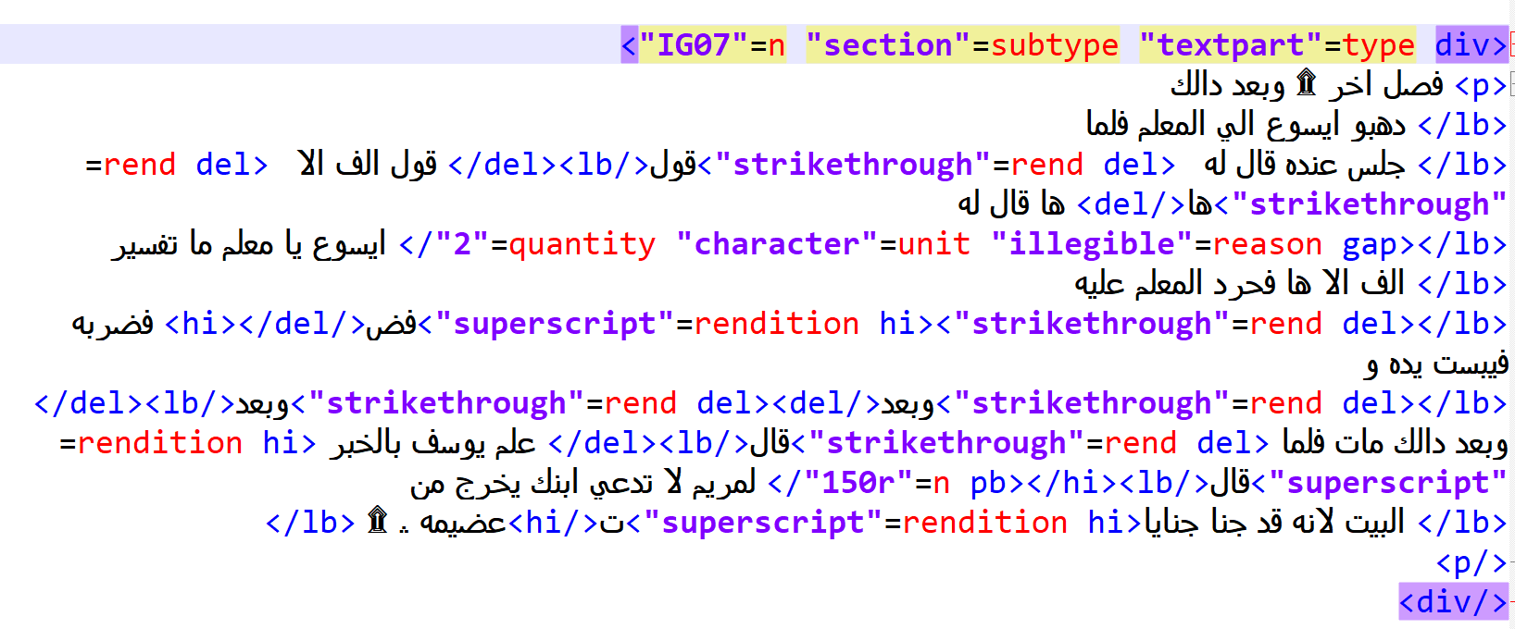
The von Stockhausen method: The result
Manuscript A

Slide 40
[SIDEBAR] New Philology: A naïve view
“…[diplomatic edition] offers no benefit over and above just digitising the manuscript…”
“…we should never do anything but reproduce the text of a ms – why not just make it available online and retire…”
King 2021: 525, 531

Slide 41
[SIDEBAR] New Philology: A naïve view
“…[diplomatic edition] offers no benefit over and above just digitising the manuscript…”
“we should never do anything but reproduce the text of a ms – why not just make it available online and retire…”
King 2021: 525, 531
Ignores the distinction between “making available” and “transcription”
Has a naïve view of what “digitizing” entails
Reading manuscripts is a skill ← Ὧδε ἡ σοφία ἐστίν
No concern for empirical soundness, no concern for reproducibility, no concern for method → NOT SCIENCE

Slide 42
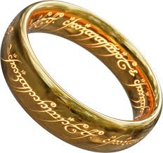
The von Stockhausen method: Limitations
still aims at creating one text to rule them all
still favors one set of variants over another
the data model for the variants is very much the Old Philology model (add., om., del., illeg., lac., transp., corr., conj., crux) (https://www.ediarum.org/docs/ediarum.ANTIQUITY.data-model/Dokumentation/ANTIQUITY/de-DE/concept/text/con_var_typisierung.html)
geared towards digital editions
Kritische Edition
what if none of that?

Slide 43
Variant presentation: Digital vs. printed
Digital
Printed
virtually no space limitations
text size, margins etc. can be increased and decreased
ancillary data can be separated and hidden
BUT ephemeral and still devalued
hard limit on book size (~ 14 x 21 cm)
hard limit on font size
BUT still the touchstone of academic achievement

Slide 44
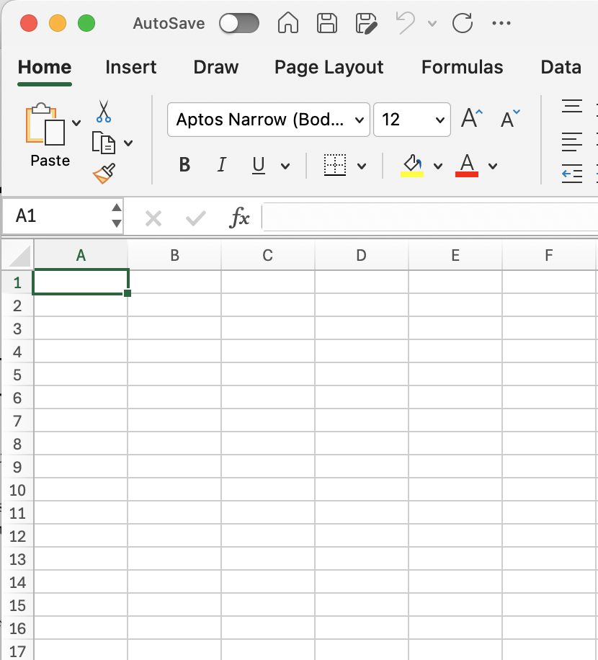
Variant presentation: Type 1
Jennott 2017: 64 (The First Apocalypse of James)

Slide 45
1
A IG07 | B IG07 | C IG07
فصل اخر ۩ |  | العجيبة الحادي عشر
وبعد دالك دهبو ايسوع الي المعلم | وبعد دلك دهبوا بيسوع الي المعلم | ومن بعد هذه دهبوا بايسوع الي المعلم.
فلما جلس عنده قال له قول الف الا ها | قال له قل الف با | فلما جلس عنده قال له المعلم قل الف الا هاً.
قال له ايسوع يا معلم ما تفسير الف الا ها | فلم يقل | فقال له ايسوع اخبرني انت قبل كل شي ماذا تفسير الف الا هاً.
فحرد المعلم عليه فضربه | فجرد عليه وضربه | فحرد عليه المعلم رغم وظربه
فيبست يده وبعد دالك مات | فيبست يد المعلم وبعد شياً مات | فيبست يد المعلم علي المكان ومات.
فلما علم يوسف بالخبر قال لمريم | فلما علم يوسف قال لامه | فلما علم يوسف بالخبر قال لمريم
لا تدعي ابنك يخرج من البيت | يا مريم لا تدعي هده العلام يخرج من البيت | لا تتركي ابنك يخرج من البيت
لانه قد جنا جنايا عضيمه ۩ | لانه اجنا جنااه عظيمه | فانه قد خبا جنايات عظيمه مختلفه.

Slide 46
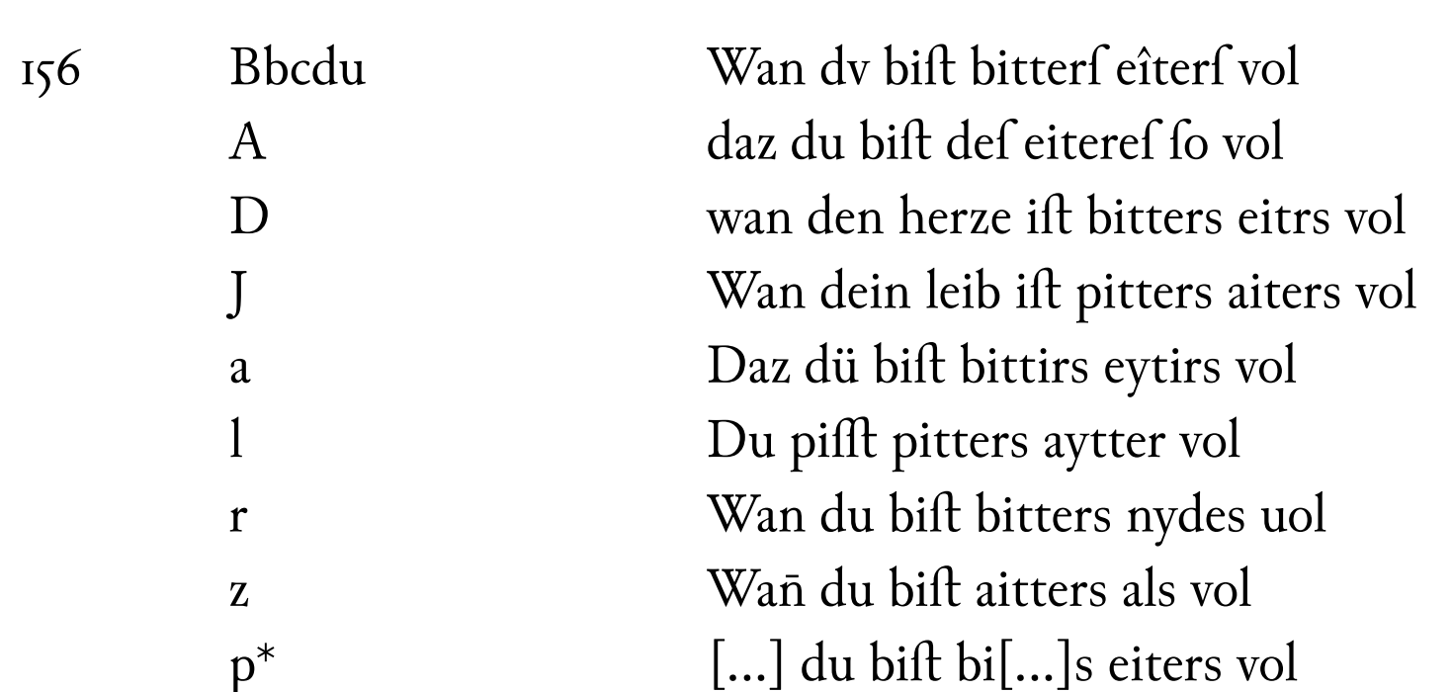
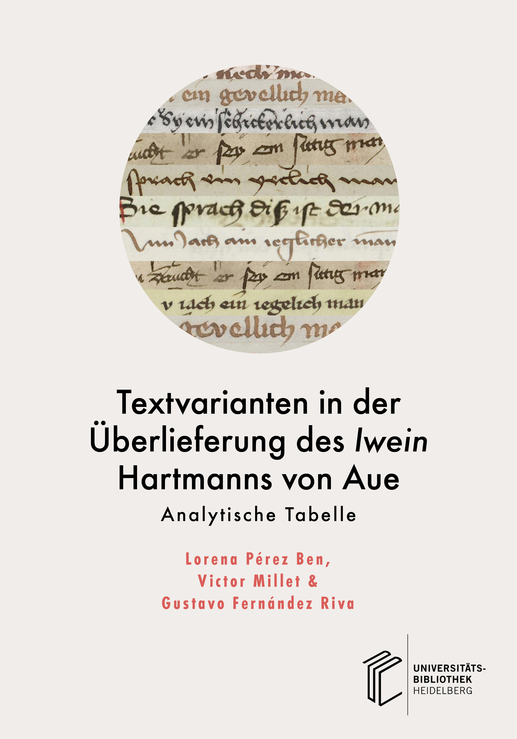
Variant presentation: Option 2a

Slide 47
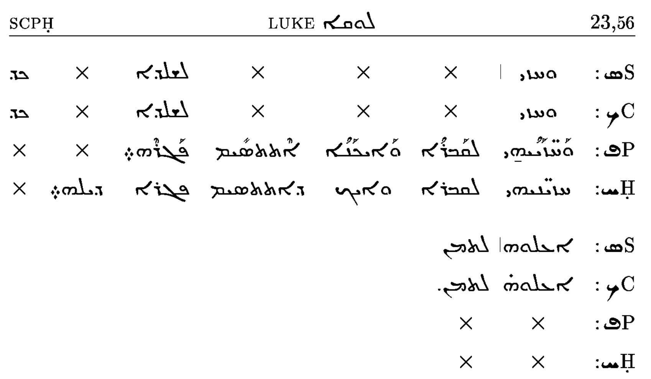
Variant presentation: Option 2b
Kiraz, George. Comparative Edition of the Syriac Gospels: Aligning the Sinaiticus, Curetonianus, Peshitta and Harklean Versions. Piscataway, NJ, USA: Gorgias Press, 2004. https://doi.org/10.31826/9781463209667.

Slide 48
2a
فصل اخر ۩ | A IG07:1 | Another chapter
_ | B IG07:1 | _
العجيبة الحادي عشر | C IG07:1 | Eleventh miracle
وبعد دالك دهبو ايسوع الي المعلم | A IG07:2 | And after that, they brought Jesus¹ to the teacher.
وبعد دلك دهبوا بيسوع الي المعلم | B IG07:2 | And after that, they went with Jesus² to the teacher.
ومن بعد هذه دهبوا بايسوع الي المعلم. | C IG07:2 | And after all that, they went with Jesus¹ to the teacher.
فلما جلس عنده قال له قول الف الا ها | A IG07:3 | And when he sat down at his place, he said to him, “Say alif without hā’!”
قال له قل الف با | B IG07:3 | He said to him, “Say alif bā’!”
فلما جلس عنده قال له المعلم قل الف الا هاً. | C IG07:3 | And when he sat down at his place, the teacher said to him, “Say alif without hā’!”
قال له ايسوع يا معلم ما تفسير الف الا ها | A IG07:4 | Jesus said to him, ”Teacher, what is the meaning of alif without hā’?”
فلم يقل | B IG07:4 | He did not say it.
فقال له ايسوع اخبرني انت قبل كل شي ماذا تفسير الف الا هاً. | C IG07:4 | And Jesus said to him, “First you tell me, what is the meaning of alif without hā’?”

Slide 49
2b
 | اخر ۩ | فصل | A IG07:1
 |  | x | B IG07:1
عشر | الحادي | العجيبة | C IG07:1
المعلم | الي | ايسوع | دهبو | دالك | وبعد | x | A IG07:2
المعلم | الي | بيسوع | دهبوا | دلك | وبعد | x | B IG07:2
المعلم | الي | بايسوع | دهبوا | هذه | بعد | ومن | C IG07:1
ها | الا | الف | قول | له | قال | عنده | جلس | فلما | A IG07:3
با | x | الف | قل | له | قال | x | x | x | B IG07:3
هاً | الا | الف | قل | له | قال | عنده | جلس | فلما | C IG07:3

Slide 50
Variant presentation: Challenges
1. Space
words can be moved around easier than larger units
how do we split the text (chapter and “verse” vs. syntax?)
فلما جلس عنده قال له قول الف الا ها | A IG07:3
قال له قل الف با | B IG07:3
فلما جلس عنده قال له المعلم قل الف الا هاً. | C IG07:3

Slide 51
Variant presentation: Challenges
1. Space
words can be moved around easier than larger units
how do we split the text (chapter and verse vs. clause?)
alignment in case of larger variation
n = 10 | قال له ايسوع يا معلم ما تفسير الف الا ها
n = 2 | فلم يقل
n = 13 | فقال له ايسوع اخبرني انت قبل كل شي ماذا تفسير الف الا هاً.

Slide 52
Variant presentation: Challenges
2. Variant type and visualization
accidental vs. purposeful?
form vs. content
only a handful of ways to visualize
وبعد دالك دهبو ايسوع الي المعلم | A IG07:2 | And after that, they brought Jesus¹ to the teacher.
وبعد دلك دهبوا بيسوع الي المعلم | B IG07:2 | And after that, they went with Jesus² to the teacher.
ومن بعد هذه دهبوا بايسوع الي المعلم. | C IG07:2 | And after all that, they went with Jesus¹ to the teacher.
لانه قد جنا جنايا عضيمه ۩ | A IG07:9 | because he has already committed great crimes.
لانه اجنا جنااه عظيمه | B IG07:9 | because he committed great crimes.
فانه قد خبا جنايات عظيمه مختلفه. | C IG07:9 | because he has already committed various great crimes.

Slide 53
Conclusion More questions
What does New Philology aim to do?
How does one not just praise, but also honor variants (and the people who made them)?
What do the readers expect of 21st century philologists and editors?

Slide 54
THANK YOU

Slide 55
References
Bird, Graeme D. Multitextuality in the Homeric Iliad: The Witness of the Ptolemaic Papyri. Hellenic Studies 43. Washington Cambridge (Mass.): Center for Hellenic Studies Distributed by Harvard University Press, 2010.
Burdick, Anne. Digital Humanities. Cambridge, MA: MIT Press, 2012.
Burke, Tony. The Syriac Tradition of the Infancy Gospel of Thomas: A Critical Edition and English Translation. Gorgias Eastern Christian Studies 48. Piscataway (N.J.): Gorgias Press, 2019.
Elliott, J. K. A Synopsis of the Apocryphal Nativity and Infancy Narratives. Second edition, Revised and Expanded. New Testament Tools, Studies and Documents, volume 51. Leiden: Brill, 2016.
Gárriga, Luisa Lesage. Plutarch: On the Face Which Appears in the Orb of the Moon: Introduction, Edition, English Translation, and Commentary to the Critical Edition. Brill, 2021. https://brill.com/display/title/59829.
Holmes, Michael W. “Reasoned Eclecticism in New Testament Textual Criticism.” In The Text of the New Testament in Contemporary Research, edited by Bart D. Ehrmann and Michael W. Holmes, 771–802. Leiden: Brill, 2013. https://doi.org/10.1163/9789004236554_028.
Jenott, Lance. “Reading Variants in James and the Apocalypse of James: A Perspective from New Philology.” In Snapshots of Evolving Traditions, edited by Liv Ingeborg Lied and Hugo Lundhaug, 55–84. De Gruyter, 2017. https://doi.org/10.1515/9783110348057-007.
King, Daniel. “How to Edit Aristotle in Syriac: Response to Arzhanov.” Hugoye: Journal of Syriac Studies 24, no. 2 (2021): 519–36.
Klooster, Jacqueline. “New Philology and Ancient Editors: Some Dynamics of Textual Criticism.” In The Making of the Humanities, Volume III: The Modern Humanities, edited by Rens Bod, Jaap Maat, and Thijs Weststeijn, 251–63. Amsterdam: Amsterdam University Press, 2014. https://library.oapen.org/handle/20.500.12657/33363.
Lied, Liv Ingeborg, and Hugo Lundhaug, eds. Snapshots of Evolving Traditions: Jewish and Christian Manuscript Culture, Textual Fluidity, and New Philology. Texte Und Untersuchungen Zur Geschichte Der Altchristlichen Literatur, Band 175. Berlin ; Boston: De Gruyter, 2017.
Maas, Paul. Textkritik. 3rd ed. Leipzig: Teubner, 1957.
Nichols, Stephen G. “Introduction: Philology in a Manuscript Culture.” Speculum 65, no. 1 (1990): 1–10.
Pérez Ben, Lorena, Victor Millet, and Gustavo Fernández Riva. Textvarianten in der Überlieferung des Iwein Hartmanns von Aue. heiBOOKS, 2024. https://doi.org/10.11588/HEIBOOKS.1401.
Tarrant, Richard. Texts, Editors, and Readers: Methods and Problems in Latin Textual Criticism. Illustrated edition. Cambridge: Cambridge University Press, 2016.
Théophraste. Theophrastus “On First Principles” (Known as His Metaphysics). Edited by Dimitri Gutas. Theophrastus of Eresus 119. Leiden: Brill, 2010.
Trovato, Paolo, and Michael D. Reeve. Everything You Always Wanted to Know about Lachmann’s Method: A Non-Standard Handbook of Genealogical Textual Criticism in the Age of Post-Structuralism, Gladistics, and Copy-Text. Translated by Federico Poole. Revised edition. Storie e Linguaggi 7. Padova, Italy: Libreriauniversitaria.it edizioni, 2014.
Von Stockhausen, Annette. “Die Modellierung Kritischer Editionen Im Digitalen Zeitalter.” Zeitschrift Für Antikes Christentum / Journal of Ancient Christianity 24, no. 1 (July 9, 2020): 123–60. https://doi.org/10.1515/zac-2020-0019.
West, Martin L. Textual Criticism and Editorial Technique: Applicable to Greek Und Latin Texts. Teubner Studienbücher Philologie. Stuttgart: Teubner, 1973.

